Slide 1
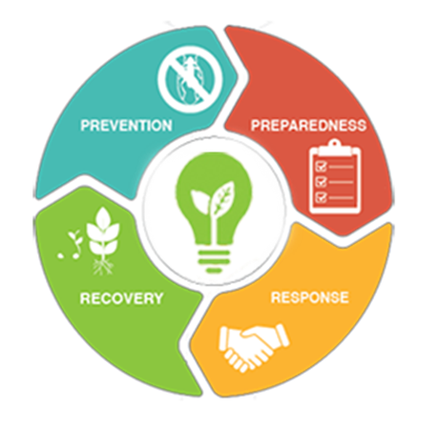

Apply for Plant Protection Act Section 7721 – Plant Pest and Disease Management and Disaster Prevention Program Funding​
PPA 7721 PPDMDPP Members:
Kelsey Bakken-Bice
Alec Ormsby (Acting)
Glorimar Marrero
Julie Van Meter

Slide 2
Presentation Overview
Up Front – Key Points for Funding Consideration
Must focus on a plant pest or disease
Must align with a single goal area and the strategies and objectives therein
Require projects with a one-year scope (i.e., deliverables in year 1)
No budget cap; budget must be proportionate to the work proposed
Must be submitted during the Open Period (July 27 – Sept. 21)
June – Aug.

Slide 3

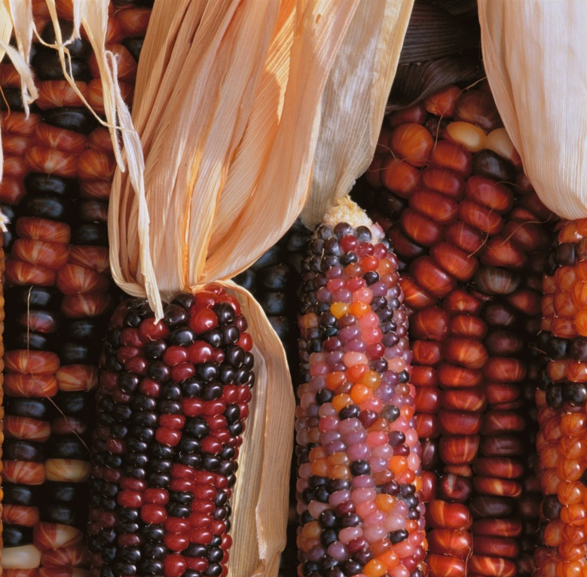

What is PPA 7721?
Plant Protection Act Section 7721 (PPA 7721)
Provides funding for projects that enhance our ability to safeguard agriculture and facilitate safe agricultural trade.
Plant Pest and Disease Management and Disaster Prevention Program (PPDMDPP):
focuses on critical needs to prevent, detect, and mitigate plant pests and diseases.
National Clean Plant Network (NCPN):
conducts diagnostic and pathogen elimination services and establishes foundation collections to provide pathogen-tested, clean plant materials to nurseries, growers, and to state certification programs.

Slide 4
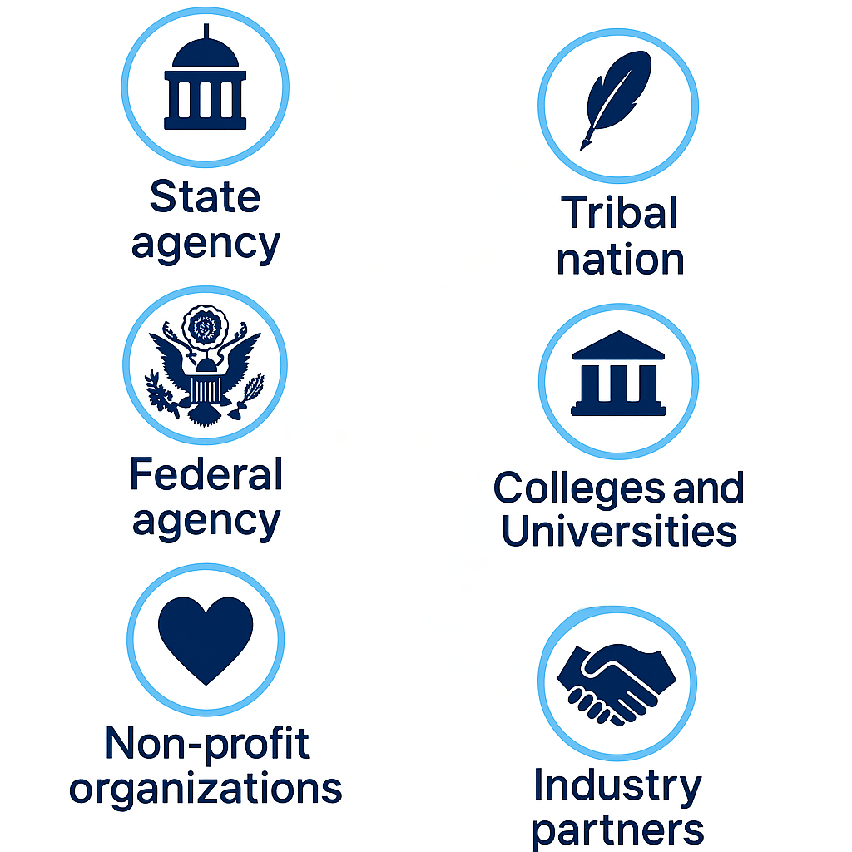


Who can apply?
State Agencies
Colleges & Universities
Federal Agencies
Industry
Non-profit Organizations
Tribal Nations &
Tribal Partners

Slide 5


Single vs Multi-Entity Suggestions
Single-entity Suggestion
Multi-entity Suggestion
A single cooperator:
Receives funding directly from PPQ
Enters into a cooperative agreement
Works on the project
Multiple cooperators:
Receive funding directly from PPQ
Enter into individual cooperative agreements
Work on the project

Slide 6
If you have ideas that…
Enhance or increase surveillance for invasive plant pests and diseases that impact agriculture and natural resources
Increase knowledge, tools, skills, and expertise for invasive plant pest and disease prevention or response
Increase capacity to respond to plant health emergencies in an efficient and timely manner

Slide 7


Federal Sources of Invasive Plant Pest Funding
Primary function of the PPDMDPP is to protect agriculture and natural resources from invasive plant pest threats, such as pests and diseases
The primary function of the Noxious Weed Eradication Program is to provide resource protection on trust lands
The BFWR Invasive Species Program focuses on addressing invasive plants and animals that negatively impact Tribes and their natural resources
noxious weeds = ↓ priority
noxious weeds = ↑ priority
noxious weeds = ↑ priority

Slide 8
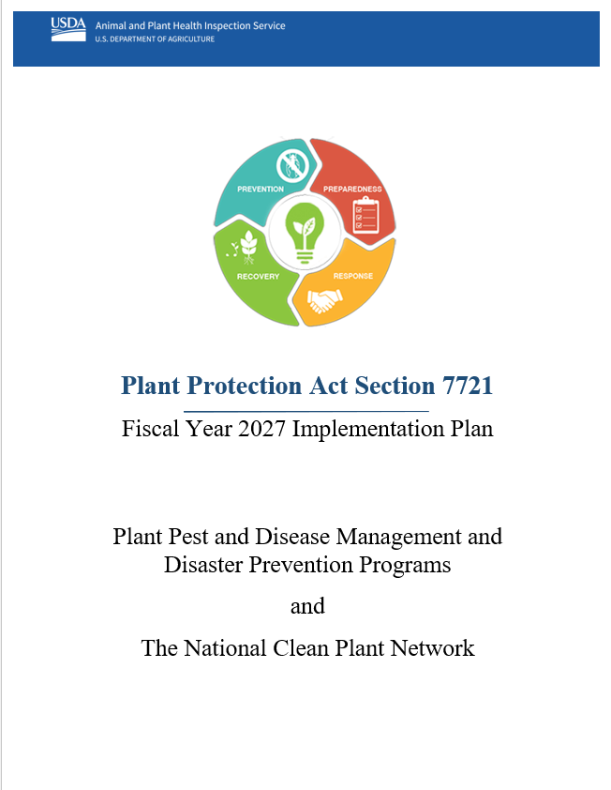
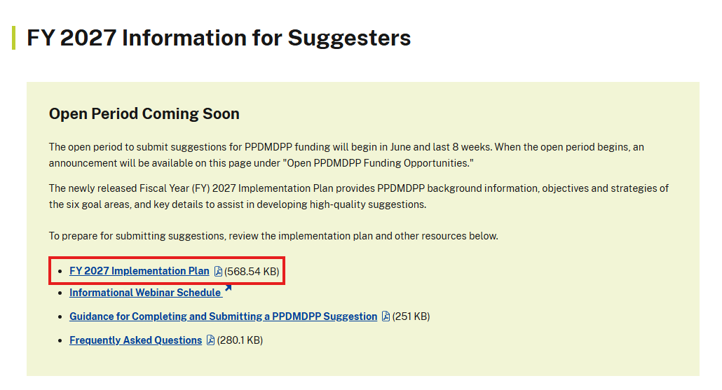
PPA 7721 Implementation Plan
https://www.aphis.usda.gov/sites/default/files/ppa7721-fy27-implementation-plan.pdf
Learn about PPQ’s pest program priorities, guidance for specific goal areas, and appropriate use of funds

Slide 9





Updates in the FY2027 Implementation Plan
Utilization of Canines
Procurement of UAVs
  Office of Management and Budget Memorandum M-26-02
NEPA Compliance
Plant Pest Permits
Outreach Prioritization

Slide 10
Enhance Plant Pest and Disease Analysis
1A
Do submit suggestions for projects that use available data to develop tools or applications that assess plant pest threats and support decision-making.
Do not submit suggestions for projects to conduct experiments or surveys.
Objectives:
Develop analytical tools or methodologies that help APHIS or state partners identify or define plant pest and pathway risks using available data.
Develop risk-based models and decision-support algorithms, approaches, or tools to reduce the entry, establishment, and spread of invasive plant pest species.

Slide 11
Enhance Plant Pest and Disease Survey
1S
Do submit suggestions to conduct surveys for regulated pests that target multiple pathways, or that provide preliminary identification of samples.
Do not submit suggestions to produce job aids, to conduct outreach, or to conduct surveys that support research activities in G1S.
Objectives:
Conduct invasive plant pest surveys and provide taxonomic expertise to increase diagnostic capacity in support of agriculture crops, specialty crops, trade, and identified program surveys listed below under Survey Strategy.
Target multiple high-risk pathways across the United States to prevent invasive plant pest introductions and improve preparedness and response capabilities.

Slide 12
Targeting Domestic Inspection
2
Do submit suggestions that aim to conduct inspections of moving articles or expand the use of canine inspection teams.
Objectives:
Promote and expand inland inspections of high-risk
pathways for regulated articles and plant pest movement.
Expand the use of canine teams for domestic inspection activities (excluding domestic survey/detection activities).
Suggestions that use canine teams for domestic surveys or to conduct mitigation activities should be submitted to G1S and G6, respectively.

Slide 13

Targeting Domestic Inspection (cont.)
2
E-commerce:
E-commerce can represent a vulnerable pathway in the safeguarding continuum.
PPA funding may assist with initial development of new e-commerce regulatory programs.
Include the long-term plan for continuing the program after the PPA funds end.

Slide 14
Enhance Pest Identification and Technology
3
Do submit suggestions that aim to improve survey technologies and tools or develop diagnostic tests or identification resources.
Do not submit suggestions that aim to utilize canine detection teams or support nursery certification programs to G3.
Objectives:
Develop/improve all aspects of early detection technologies and resources.
  Such as developing or improving survey methods, trap technologies, and lures or attractants
Develop or improve diagnostic tests, identification resources, and taxonomic expertise for high priority plant pests.
  Such as developing, validating, or improving diagnostic methods, including molecular-based assays and other technologies, to detect and/or identify plant pests.

Slide 15
Safeguard Nursery Production
4
Do submit suggestions that aim to develop and integrate BMPs in nurseries or improve certification programs.
Objectives:
Develop science-based best management practices (BMPs) and risk mitigation practices to exclude, contain, and/or control regulated pests from the nursery production chain.
Support development or improvement of nursery certification programs, including the harmonization of different certification programs (both inter- and intra-state).
Suggestions that focus on tools for early detection should be submitted to G3. Suggestion focused on outreach should be submitted to G5

Slide 16
Conduct Outreach and Education
5
Do submit suggestions that aim to increase awareness of plant pest issues in target groups.
Do not submit suggestions that aim to collect, track, or report invasive species, fund career development, or conduct surveys to G5.
Objectives:
Provide education and encourage behaviors that enhance safeguarding activities.
Increase the number of people actively looking for and reporting high-consequence plant pests at vulnerable points along high-risk pathways.
Increase public awareness and support for high priority plant pest and disease
eradication programs and acceptance of control efforts.

Slide 17

Conduct Outreach and Education (cont.)
5
Target audiences prioritized → high to low ranking
Suggestions should:
  Clearly identify the target audience(s)
  Include expected results and metrics for the outreach
  Provide an evaluation plan for proposed activities

Slide 18
Enhance Mitigation Capabilities and Rapid Response
6
Do submit suggestions that aim to improve available tools and develop ready-to-use technologies that support plant health emergencies.
Do not submit suggestions to conduct detection surveys, develop traps or lures, complete diagnostics, or conduct outreach to G6.
Objectives:
Develop or adapt new control technologies, tools, and treatments for use in plant pest emergencies and/or established pest programs.
Improve response options and capabilities in preparation for a potential plant pest emergency
Support the use of existing tools and initial response protocols for the overarching goals of containment, control, and/or eradication of plant pests.

Slide 19

Enhance Mitigation Capabilities and Rapid Response (cont.)
6
Rapid Response:
Supports suggestions that address an immediate need for mitigation or treatment of an emerging, invasive plant pest of federal concern.
Funding may be used to support plant pest emergencies that occur throughout the year.

Slide 20
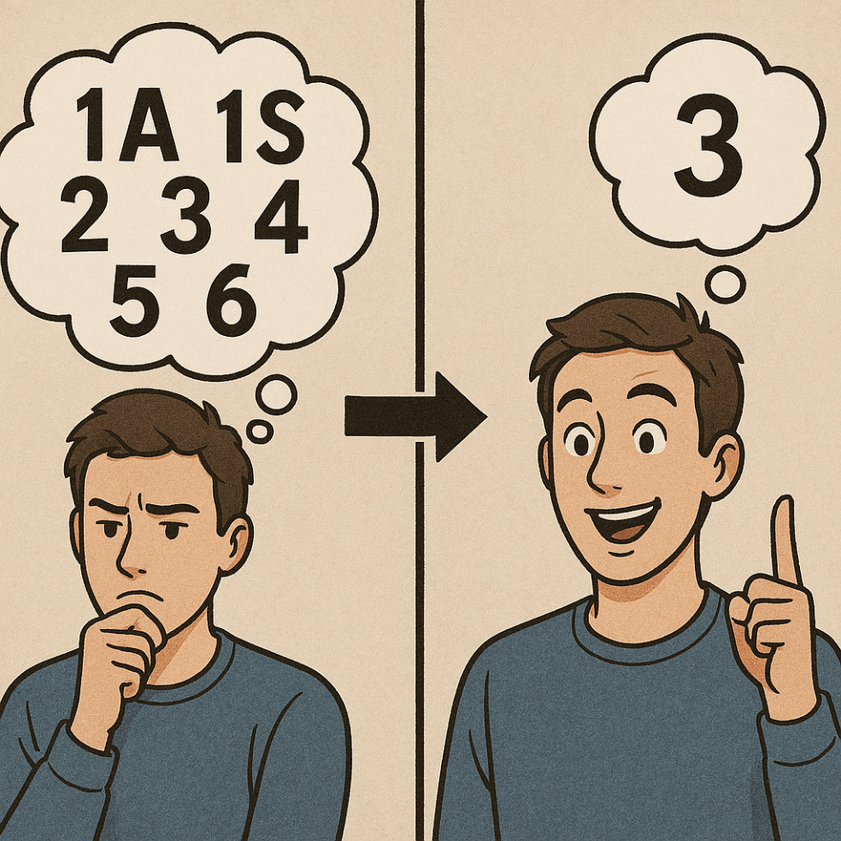
Suggestion Requirement – Goal Area Fit
Suggestions that have aspects of multiple goal areas …
May rank lower overall;
May only receive partial funding;
Or may be dropped from consideration/not recommended for funding.
Do submit suggestions that meet the strategies and objectives of a single goal area
Do not submit suggestions that have an ambiguous or tenuous relationship to a goal area (i.e., it could fit multiple goal areas).

Slide 21
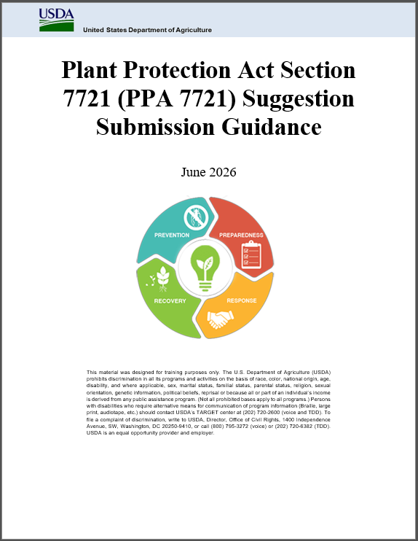
Where to Submit a PPA 7721 Suggestion
Submit PPDMDPP suggestions to ServiceNow: https://www.aphis.usda.gov/funding/ppdmdpp
Check out the:
PPA 7721 ServiceNow Suggestion Submission Guidance [https://www.aphis.usda.gov/funding/ppdmdpp]
Real-time walkthrough of ServiceNow offered:
Monday, August 17
Thursday, August 27

Slide 22
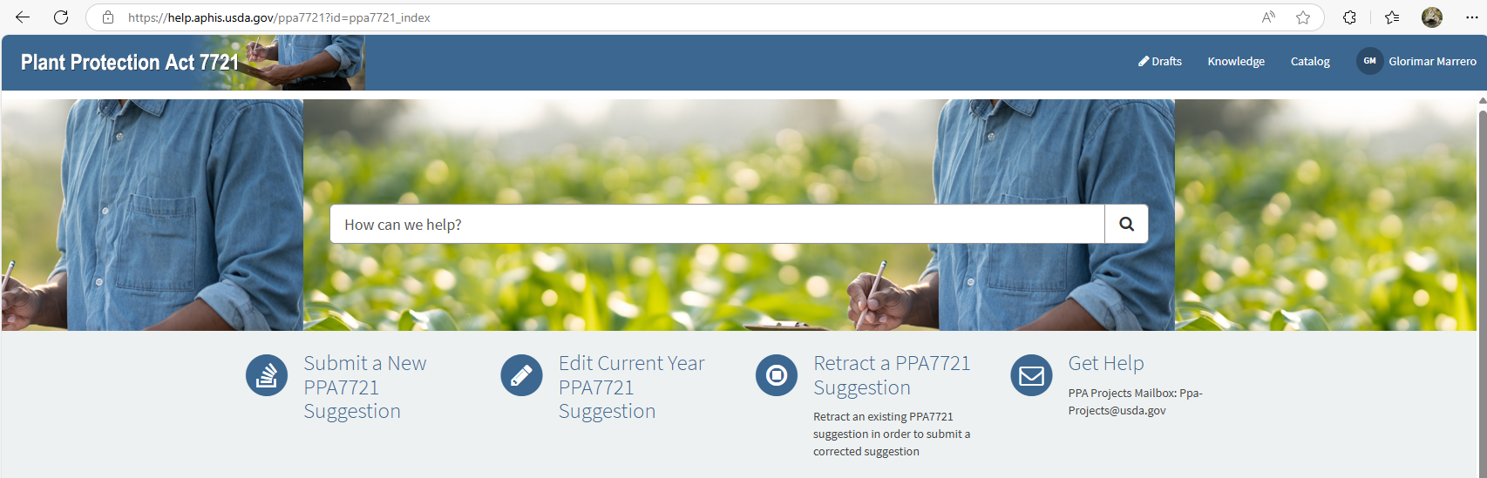
Requirements for Using ServiceNow
USDA system used to manage identity and login credentials for a variety of Department applications
Additional information available at https://www.eauth.usda.gov/eauth/b/usda/home
Video of how to register for eAuthentication

Slide 23
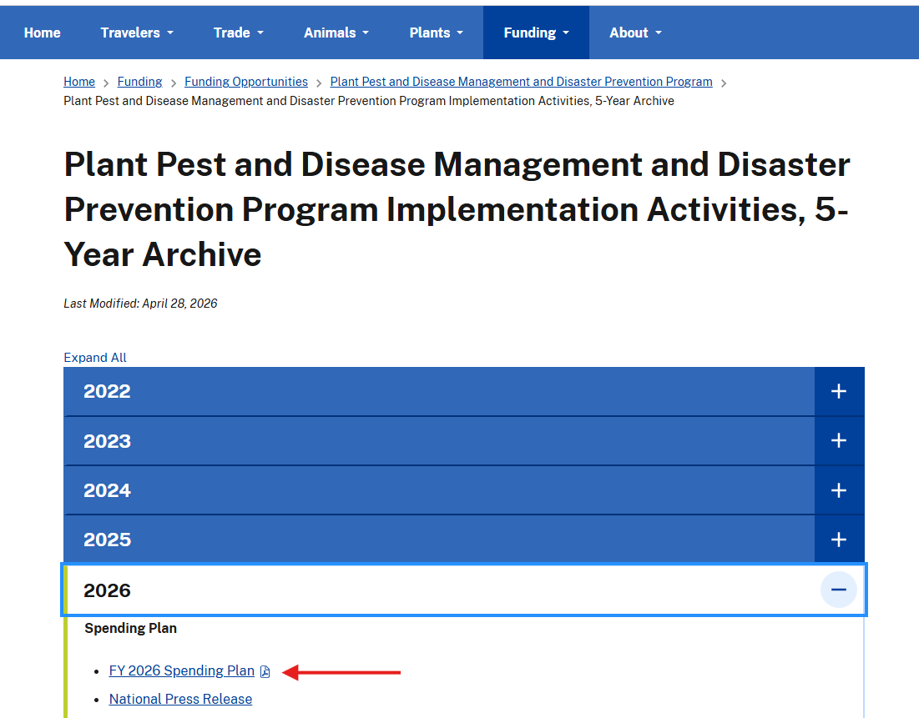
Things to Consider Before Applying
Single goal area, and its objectives and strategies
Funding is for a single year
For work or deliverables for a federal program pest (see Appendix C)
  Consider speaking with the NPM for the program pest
Hint: Review Spending Plans from prior years
  Past (5) years available at: https://www.aphis.usda.gov/funding/ppdmdpp/program-implementation-activities

Slide 24
Questions to Ponder in…
Developing Suggestions
Does my project focus on a plant pest?
Who is the intended user?
How will the tool or method be optimized?
Do I have all the required tools to develop the product?
What is the cost of the development of the tool or method, and of the end product?
What are the roles of each cooperator?
What are the measures of success?

Slide 25
What makes a good project? (1 of 4)
Focus on invasive plant pest or disease issues
Provide a clear need for the work
Do you have an idea…
Develop a strategy to detect or manage an invasive plant pest
Promote awareness of invasive plant pest threats in your community
Working with other groups to address a common invasive plant pest problem
Ask whether…
The work is specific to your region?
Are any other groups working on this invasive plant pest issue? Potential for partnering?
Did I clearly explain how the objectives change from year to year (multi-year projects only)?

Slide 26
What makes a good project? (2 of 4)
Who:
Indian Nations Conservation Alliance
What:
Strengthen early detection, reporting, and preparedness for high-consequence plant pests by delivering regional/local ecosystem-based outreach, education, and training tailored to the crop types, ecosystems, and needs of each Tribal (Nations) community
Where:
Working with and impacting communities in high-risk border-state regions such as Southern California, Montana, Wyoming, and Western Oklahoma
Tribal First Detectors Network
APHIS-PPQ
State Departments of Agriculture
Tribal Colleges and Universities
Intertribal Organizations

Slide 27

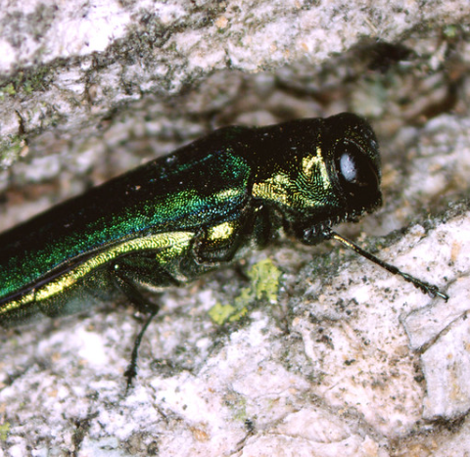
What makes a good project? (3 of 4)
Who:
Saint Regis Mohawk Tribe
What:
Slow the progression of ash mortality and take steps toward maintaining forest health by implementing emerald ash borer mitigation activities
Where:
Saint Regis Mohawk Reservation, Akwesasne, in New York

Slide 28
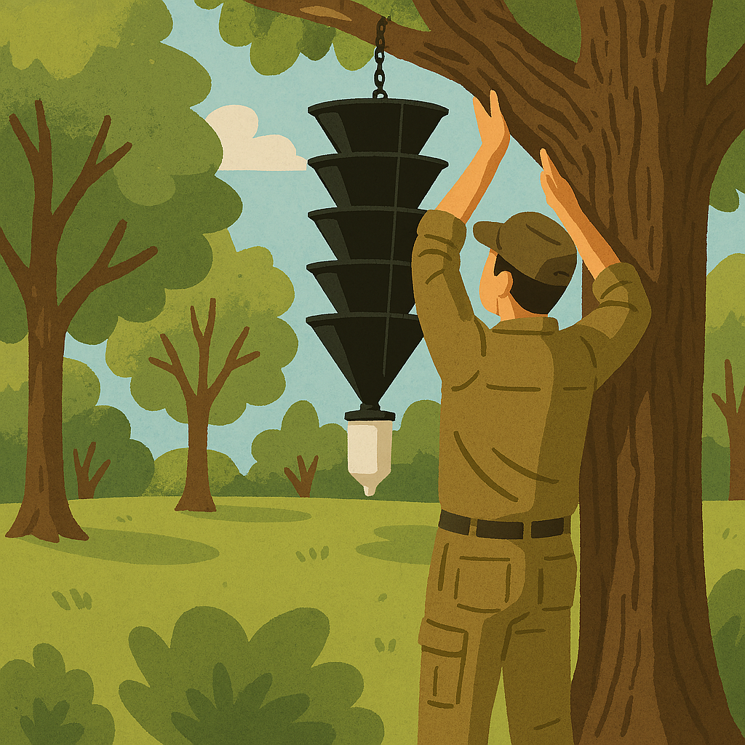
What makes a good project? (4 of 4)
Who:
Wisconsin Tribal Conservation Advisory Council
What:
Coordinated pest survey initiative to expand plant pest survey efforts in high-risk areas, such as around lakes, recreational areas, and other locations on Tribal lands
Where:
Tribal lands throughout Wisconsin

Slide 29
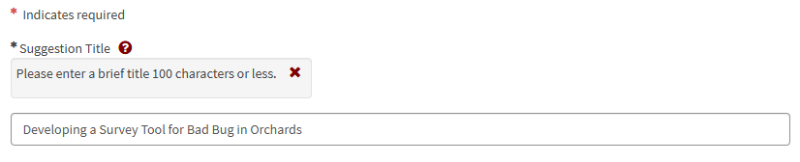
Components of a Good Suggestion (1 of 11)
Use a concise, descriptive title outlining activities
Example

Slide 30
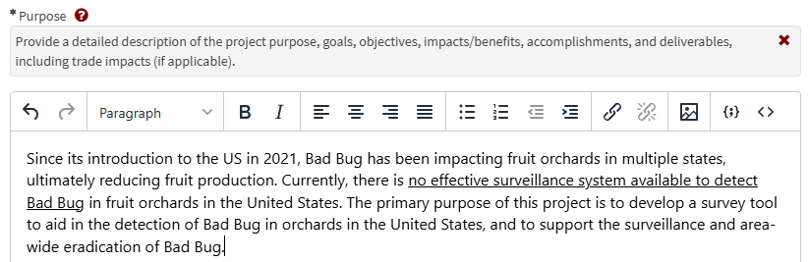
Components of a Good Suggestion (2 of 11)
Include detailed background information to justify the need
Example

Slide 31
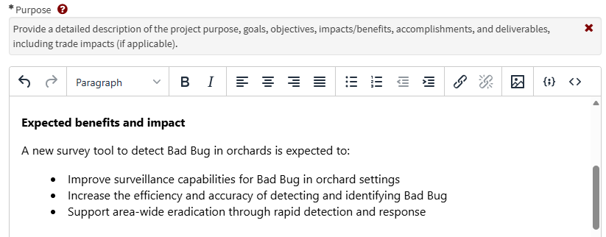
Components of a Good Suggestion (3 of 11)
Clearly outline benefits to PPQ and stakeholders
Example

Slide 32
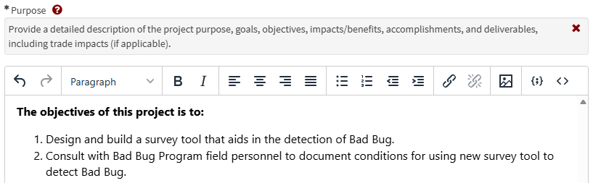
Components of a Good Suggestion (4 of 11)
Objectives should be specific to a single year project, with longer-term projects providing distinct deliverables for the application year
Example

Slide 33
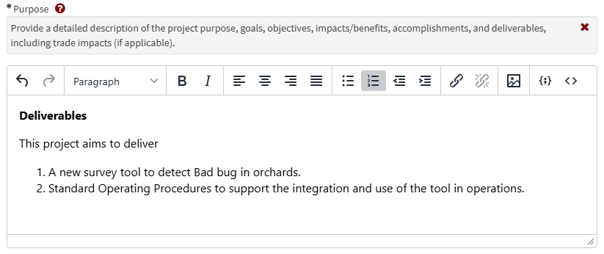
Components of a Good Suggestion (5 of 11)
Clearly describe suggestion deliverables
Example

Slide 34
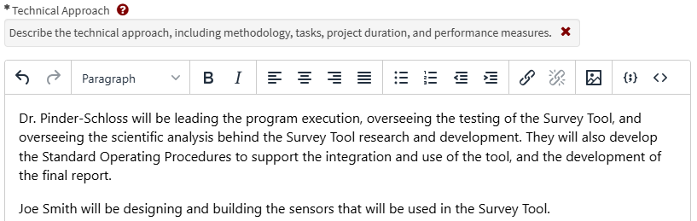
Components of a Good Suggestion (6 of 11)
Clearly state all cooperators participating in the project and describe their specific activities with sufficient technical detail.
Example

Slide 35
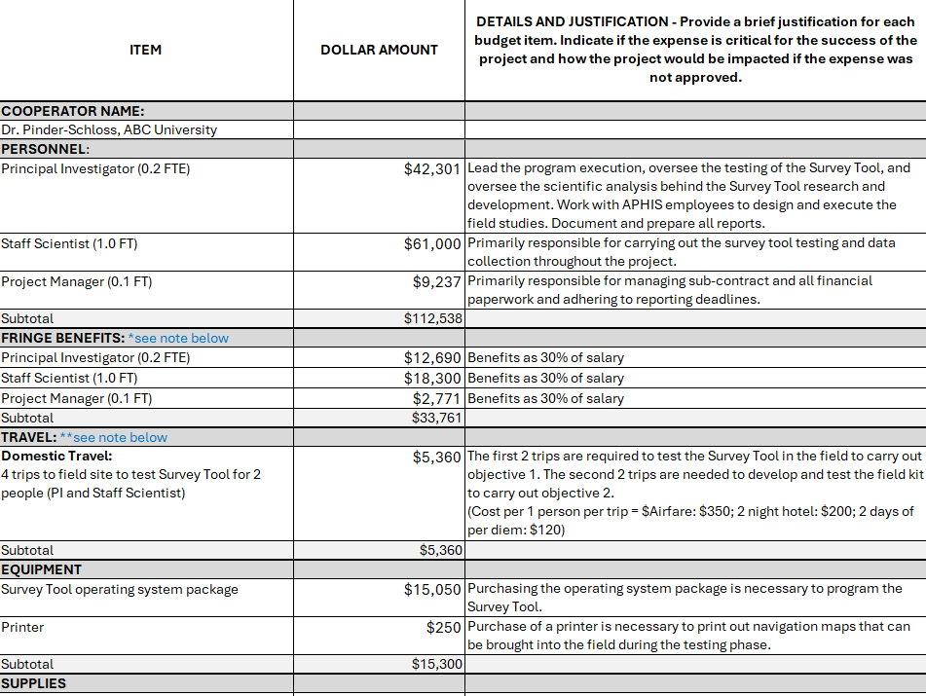
Components of a Good Suggestion (7 of 11)
* Use the correct budget template!
Example
Include a descriptive budget and justification that outlines the need for funds for each activity

Slide 36
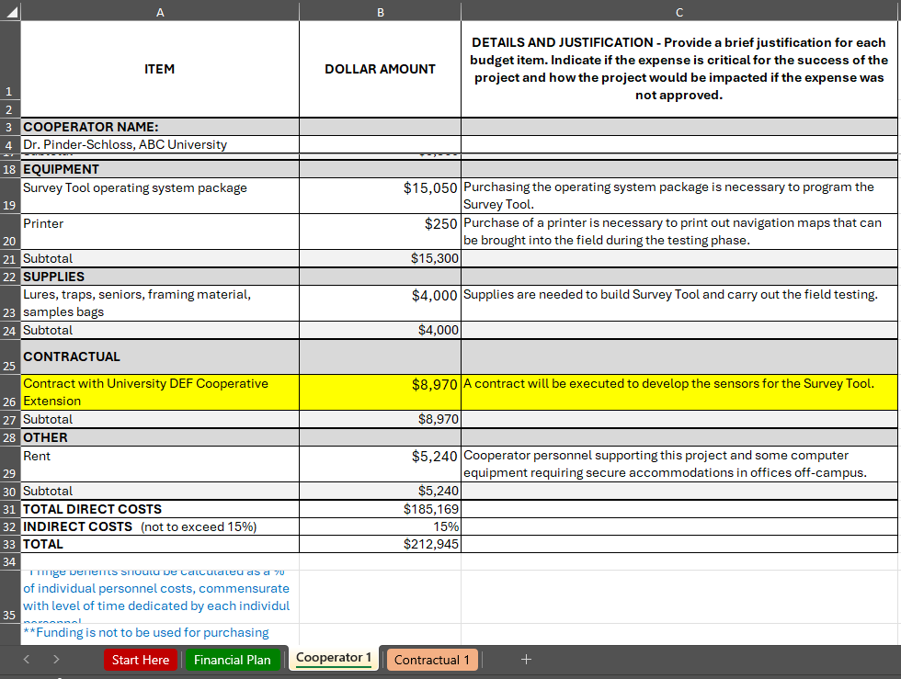
Components of a Good Suggestion (8 of 11)
Example
Include a descriptive budget for each participating cooperator

Slide 37
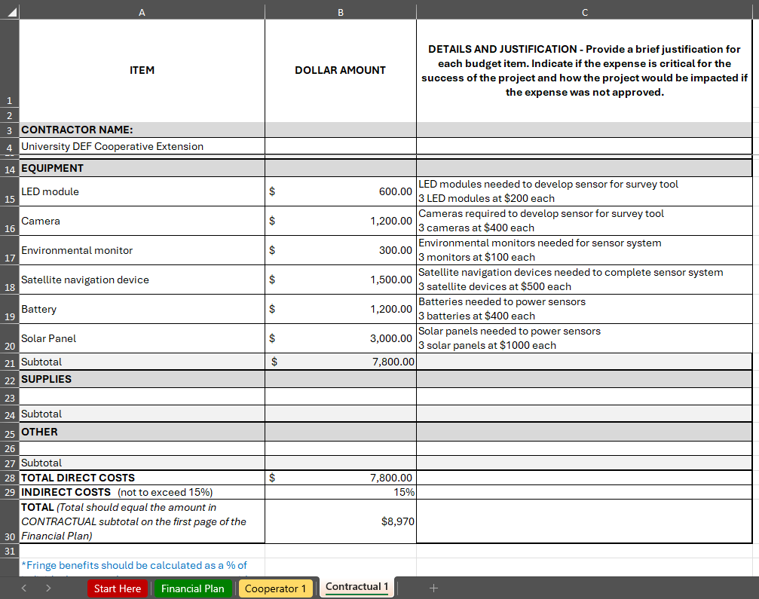
Components of a Good Suggestion (9 of 11)
Example
Include a descriptive budget for each participating cooperator

Slide 38
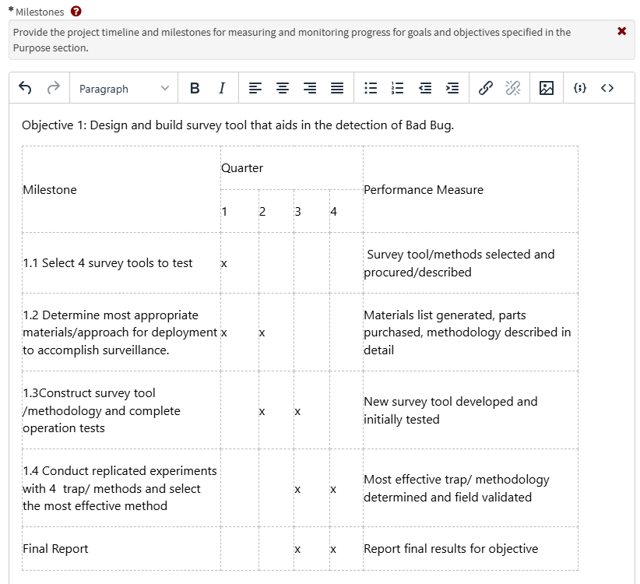
Components of a Good Suggestion (10 of 11)
Describe clear measures of success throughout the project

Slide 39
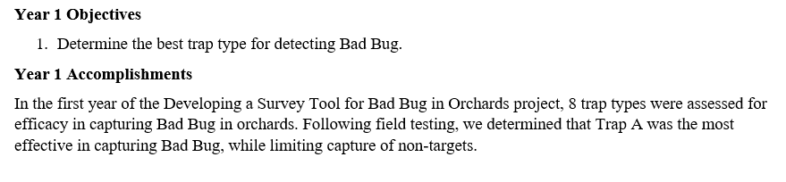
Components of a Good Suggestion (11 of 11)
Progress and accomplishments for continuing projects should be clearly described
Example

Slide 40
How to Apply for PPDMDPP Funding
Step 1
Step 2
Step 3
Step 4
Register for Stakeholder Registry — Receive Spending Plan/funding notification
Review the
FY 2027 PPDMDPP Implementation Plan
Ensure access to eAuthentication and ServiceNow
Submit suggestion in ServiceNow

Slide 41
Review Process & Evaluation Criteria (1 of 2)
Strategic Alignment
Plant Protection Act Section 7721
Impact/Outcome
Project Results
Feasibility
Resources, partnerships, process
Past Performance, Best Practices and Innovation
Budget
Internal and External Participants
Coordinated review
Leading to rating, then ranking of suggestions

Slide 42
Review Process & Evaluation Criteria (2 of 2)
Does not address an invasive plant pest issue
Missing required documentation
• Templates
• Progress Report
Fails to use the most current templates(s)
Goal 1S
Budget
Submitted under the wrong goal area
Not all questions answered
Incomplete suggestions
What suggester errors will result in a suggestion being eliminated from consideration?

Slide 43
Common Errors and Misconceptions
MISCONCEPTIONS
ERRORS
Funding in one year guarantees funding in future years
Returning suggestions should be submitted to the same goal area
The Implementation Plan never changes
I’ve done this before, I don’t need to attend informational webinars every year
Not clearly specifying each cooperator’s contribution to the proposed work (multi-entity suggestion)
Not providing evidence of how deliverables from a prior year are different or build on proposed work in a new year
Copy/pasting the ‘Abstract’ in the ‘Purpose’ field
Submitting the same suggestion to two goal areas

Slide 44
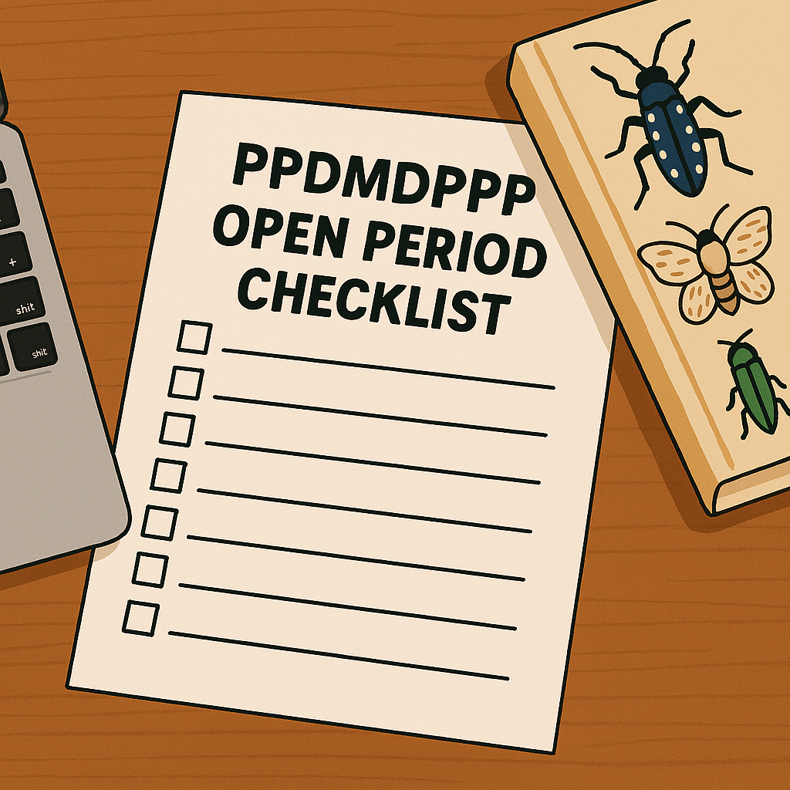
Let’s go through a checklist
Review the FY 2027 Implementation Plan
  Identify the appropriate goal area for the suggestion idea
  *must be a single goal area*
    Within the goal area, what objective and strategies will this project incorporate?
Develop suggestion activities with these components in mind:
  Concise, descriptive title
  Define specific activities for each cooperator
  Provide detailed background information
  Clearly outline benefits to PPQ and stakeholders
  Provide single year objectives and deliverables
  Describe budget and justification for funds
Submit suggestion during open period from
July 27 – September 21, 2026

Slide 45
PPDMDPP Timeline
May
June
July
August
September
October
November
December
January
February
March
Implementation Plan released
Review Period – Suggestions are reviewed by multiple groups and recommendations for funding are made
Cooperative agreements are initiated
Open Period – Submit Suggestions
Spending Plan is released when funding recommendations are finalized

Slide 46
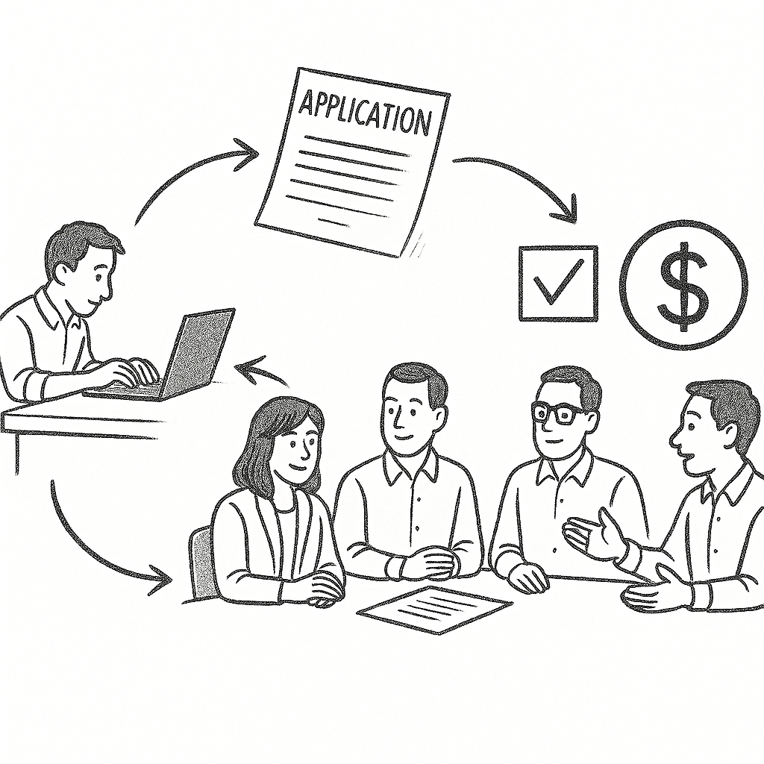
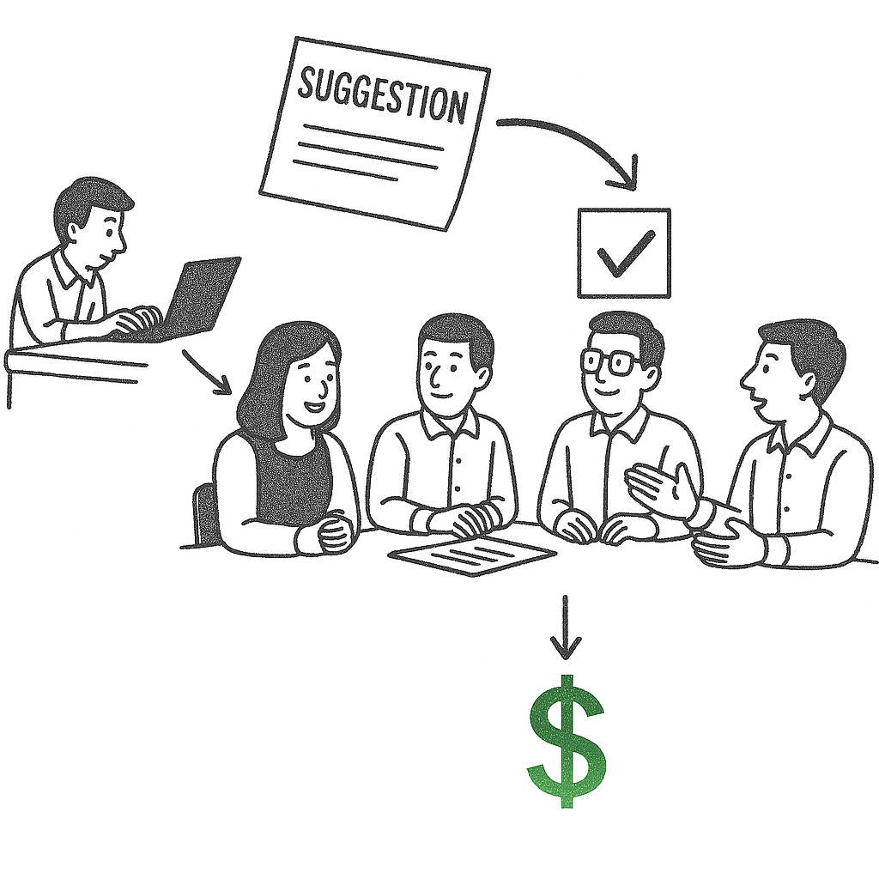


What Are Cooperative Agreements?
Grants
Development of project without assistance from both parties
*Limited involvement
Cooperative Agreements
Both parties participate in the development of project objectives and activities
*Substantial involvement

Slide 47
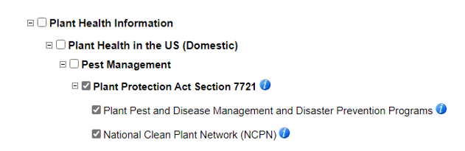
Notification of Funding Decision
Funding decisions are announced and published in the PPA 7721 Spending Plan
  Direct notification of funding decisions are not made
Spending Plan is anticipated to be released between early January to March
Register for the Stakeholder Registry to receive updates on the release of the Spending Plan (as well as the Implementation Plan and Open Period)
Stakeholder registry:
https://public.govdelivery.com/accounts/USDAAPHIS/subscriber/new

Slide 48

Contribute to PPA 7721 as a Reviewer
Be part of the solution in solving problems for U.S. agriculture and natural resources
We need subject matter experts to review suggestions during the review period
Benefits include
  CV/resume experience
  Behind-the-scenes knowledge of the PPA 7721 process
Contact us at ppa-projects@usda.gov

Slide 49

Resources
Any Questions?
?
PPA 7721 PPDMDPP Website:
https://www.aphis.usda.gov/funding/ppdmdpp
Contact us at:
ppa-projects@usda.gov

Slide 50
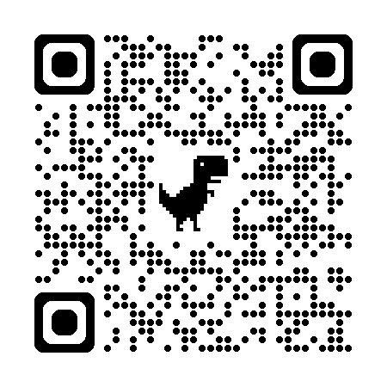
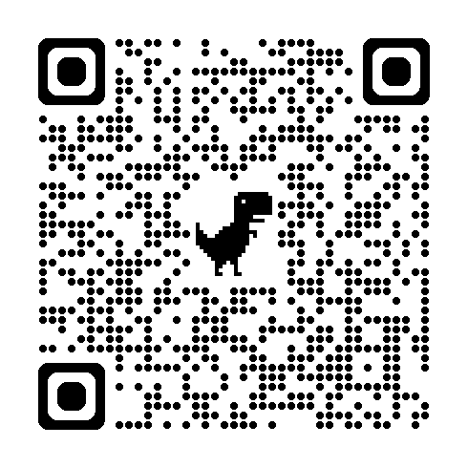
Additional Resources – Department of Interior
Branch of Fisheries, Wildlife and Recreation Invasive Species Program
Noxious Weed Eradication Program
The primary function of the Noxious Weed Eradication Program is to provide resource protection on trust lands
The BFWR Invasive Species Program focuses on addressing invasive plants and animals that negatively impact Tribes and their natural resources
thomas.mendez@bia.gov
trina.locke@bia.gov
https://www.bia.gov/service/noxious-weed-eradication
https://www.bia.gov/service/competitive-fisheries-wildlife-recreation-programs/invasive-species

