Slide 1


Slide 2
Hungry Pests threaten to destroy America’s crops and ecosystem. They can harm the economy, environment, and human health.

Slide 3


Slide 4
The Cost of Invasive Pests
The Cost of Invasive Pests
Some scientists estimate that the economic impact exceeds $1 billion annually due to lost revenue and clean-up costs.
Managing invasive pests requires costly research, development, and application of control technologies.

Slide 5
The Cost of Invasive Pests
Invasive pests threaten agricultural jobs and raise our food prices by:
  Damaging crops
  Costing millions of dollars in treatments to farmers and government agencies at all levels
  Closing foreign markets to U.S. products from affected areas

Slide 6
In today’s global marketplace, the volume of international trade brings increased potential for these invaders to enter our country.

Slide 7
Keeping these pests and diseases out of the country is the number one priority of the U.S. Department of Agriculture’s Animal and Plant Health Inspection Service (APHIS) and the reason we developed this outreach effort.

Slide 8
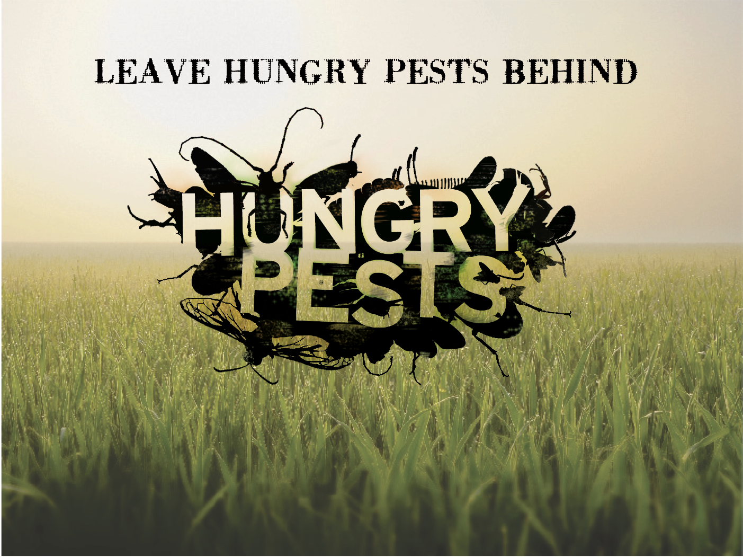

Slide 9
Just How Damaging are Invasive Pests to America’s Farmland and Natural Ecosystems?

Slide 10
Hungry Pests
Grow and spread rapidly
Push out native species
Reduce biological diversity
Damage parks, forests, and gardens
Place other species at increased risk of extinction
Damage crops
Close foreign markets to U.S. products from infested areas
Can be dangerous to human health

Slide 11
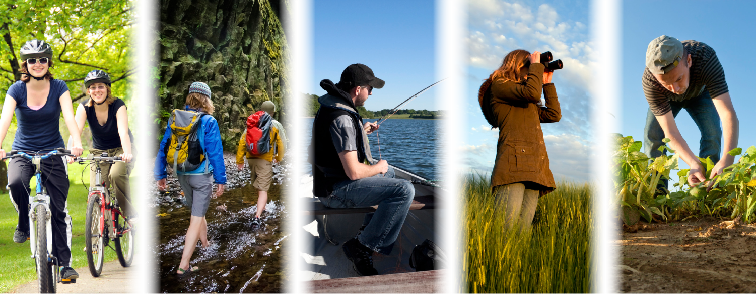
Hungry Pests Directly Affect Your Life

Slide 12
How Do They Get Here?
Though some invasive pests slip into the U.S. naturally via wind, ocean currents, and other means, it’s uncommon.
Most get help from human activities or transport.
  — They may be brought into the country and released intentionally
  — Or moved and released unintentionally through
  cultivation, commerce, tourism, or travel

Slide 14
Hungry Pests are Hitchhikers
Cargo, mail, and passenger baggage, or as contaminants of commodities
Containers, crates, or pallets
Agricultural produce, nursery stock, cut flowers, and timber
Military cargo transport
Ballast water released from ships as cargo is loaded
and unloaded

Slide 15
Hungry Pests are Hitchhikers
Once in the country, they hide and ride in or on:
Plants
Fruit and vegetables
Firewood and camping gear
Boots and clothing
Outdoor furniture and other outdoor items

Slide 17
Protecting America Against Invasive Species
The job of APHIS Plant Protection and Quarantine (PPQ) program is to block the entry of these Hungry Pests, and if they do slip through, to respond rapidly and effectively to minimize the damage.

Slide 18
Protecting America Against Invasive Species
PPQ:
Safeguards U.S. agricultural and natural resources from risks associated with the entry, establishment, or spread of agricultural pests and diseases, as well as invasive and harmful weeds.
Collaborates with many government partners at the Federal, State, county, and local levels, plus universities and nongovernmental organizations.

Slide 19
How Do We Accomplish This Complex Mission?
PPQ fights invasive pests on 3 fronts:
The first front is Abroad—we fight pests and diseases over there so they don't come over here. This means:
Assisting other countries in their pest and disease survey, control, suppression and/or eradication efforts.
Inspecting certain U.S.-bound exports to ensure they're pest- and disease-free before they depart.
Helping other countries to develop the capability to export safe agricultural products to the United States.

Slide 20
How Do We Accomplish This Complex Mission?
The second front is At the Border—we stop the pests at the gate. This means:
Establishing import regulations and international standards to keep out foreign animal and plant pests and diseases, as well as harmful weeds.
Supporting agricultural inspections at U.S. ports of entry by the U.S. Department of Homeland Security.
Preventing the entry of smuggled agricultural goods.

Slide 21
How Do We Accomplish This Complex Mission?
The third front is Across the Country—we search for any agricultural threats that might have slipped through. This means:
Conducting surveys for invasive pests each year with our State partners.
Detecting pests and diseases early and responding rapidly to avoid large-scale agricultural, environmental and economic losses—and to keep our export markets open.
Informing the public about the risk of invasive species and teaching them how to protect America's natural beauty and agricultural bounty.

Slide 22
All of these actions help to ensure a diverse natural ecosystem and an abundant and healthy food supply for
all Americans

Slide 23
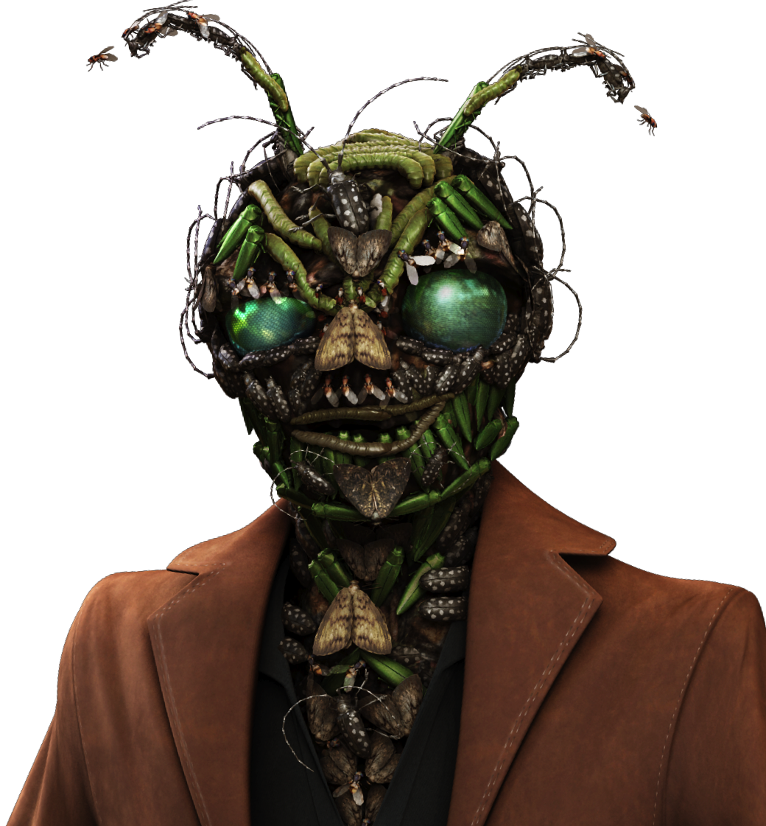

Slide 24
But Enough About Us …
What Can You Do?
Despite best efforts, APHIS and its partners can’t defeat invasive species alone. You can make all the difference in the fight.

Slide 25
Leave Hungry Pests Behind
The most important thing anyone can do is to prevent the introduction and spread of invasive pests in the first place.

Slide 26
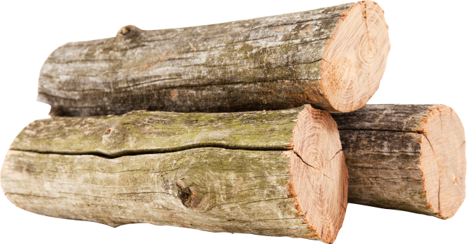
Buy Local, Burn Local
Invasive pests and larvae can hide and ride long distances in or on firewood. Don’t give them a free ride to start a new infestation—buy firewood where you burn it.

Slide 27
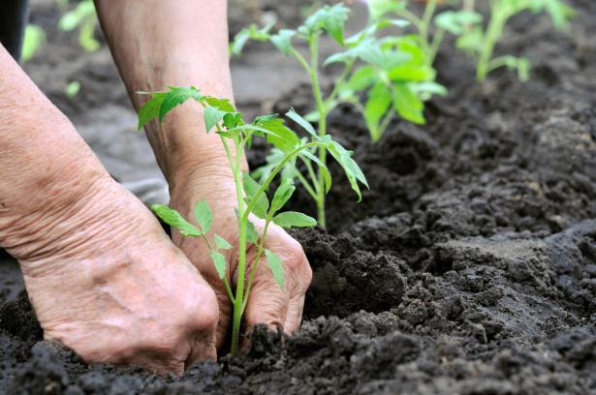
Plant Carefully
Buy your plants from a reputable source and avoid using invasive plant species at all costs.

Slide 28
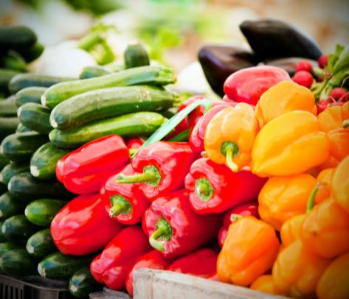
Take Care When Moving Plants and Produce
Do not bring or mail fresh fruits, vegetables, or plants into your state or another state unless agricultural inspectors have cleared them beforehand.

Slide 29
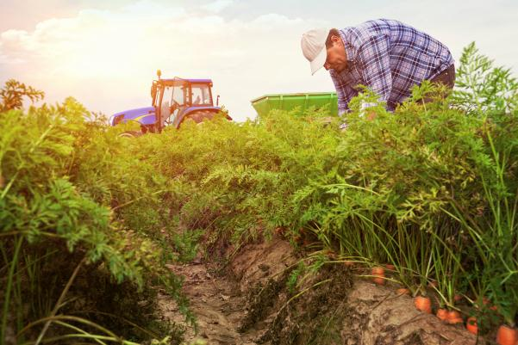
Cooperate
Follow any agricultural quarantine restrictions, and allow authorized agricultural workers access to your property for pest or disease surveys.

Slide 30
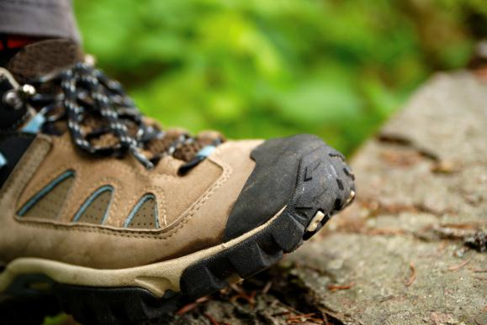
Keep It Clean
Wash outdoor gear and tires between fishing, hunting or camping trips. Clean lawn furniture and other outdoor items when moving from one home to another.

Slide 31

Learn to Identify
If you see signs of an invasive pest or disease, write down or take a picture of what you see, and then report it at:
HungryPests.com

Slide 32
Speak Up
Declare all agricultural items to customs officials when returning from international travel. Call USDA to find out what’s allowed.
(301) 851-2046 for questions about plants
— Or toll-free at 1-877-770-5990
(301) 851-3300 for questions about animals
Visit USDA's “Agricultural Information for International Travelers” Web page at www.aphis.usda.gov/travel.

Slide 33
Outdoor Enthusiasts
Learn to recognize non-native plant infestations and avoid passing through them to avoid spreading invasive plant seed.
Clean equipment, boots, animals, and gear between trips, or preferably before leaving an infested area. Make sure to remove all seeds and other plant parts.
Report invasive pest sightings at HungryPests.com.
Use weed-free hay and feed for your animals.
Don't move firewood. Buy or use firewood that is close to your campsite.

Slide 34
Hunters
Use only native plants for food plots. Native plants provide much better food and cover for wildlife.
Clean your boots, hunting gear, truck bed, and tires after a hunting trip to make sure you are not spreading seeds, insects, or spores to a new location.
Don't move firewood. Buy or use firewood that is close to your campsite.
Learn to identify the invasive species in your area.
Report any sightings at HungryPests.com.

Slide 35
Gardeners
Declare any plant material brought in from travel abroad.
Buy your plants from a reputable source. Avoid using invasive plant species at all costs.
Remove invasive plants from your garden.
Until you are able to rid your garden of invasive plants, be responsible and remember to remove and destroy seed
heads before they can spread. Also, don’t share invasives
with other gardeners.
Learn how to apply for a plant import permit at www.aphis.usda.gov/plant_health/permits

Slide 36
Gardeners
Talk to other gardeners about invasives and how you plan to help in the fight against them.
Talk to your local native plant society or exotic pest plant council if you are worried that your garden will lose its luster after removing invasives. They can suggest suitable native replacements.
Report suspected invasive species at HungryPests.com.
If you suspect agricultural smuggling, please call USDA's Smuggling Interdiction and Trade Compliance unit at
(800) 877-3835.

Slide 37
Bird Watchers
Learn to recognize infestations and avoid passing through them to avoid spreading seed of invasive plants.
Clean equipment, boots, and gear between trips or, preferably, before leaving an infested area. Make sure to remove all seeds and other plant parts.
Report any invasive sightings at HungryPests.com.
Change the water in birdbaths often to prevent mosquitoes from breeding.

Slide 38
International Travelers
Declare all food, live animals, and plant or animal products to a U.S. Customs and Border Protection officer or agriculture specialist at the first port of entry.
Research the admissibility of plant and animal products before your trip. You can call USDA at (301) 851-2046 for questions about plants and plant products, and (301) 851-3300 for questions about animals and animal products.
Visit USDA's “Agricultural Information for International Travelers” Web page at www.aphis.usda.gov/travel.

Slide 39
International Travelers
Keep in mind that certain foods are restricted in order to protect community health, preserve the environment, and prevent the introduction of devastating pests and diseases to domestic plants and animals.
If you suspect agricultural smuggling, please call USDA's Smuggling Interdiction and Trade Compliance Unit at (800) 877-3835.

Slide 40
Ranchers and Farmers
Learn to identify the invasive species in your area.
Report any sightings at HungryPests.com. The sooner
invasive species are detected, the easier and cheaper it is to control them.
Clean your boots, gear, truck bed, tires, and harvesting equipment after working a site to make sure you are not spreading seeds, insects, or spores to a new location.
Be sure to control invasive plants along fencerows, ditches,
and other areas adjacent to fields.
Use weed-free hay and feed for your animals.

Slide 41
Loggers and Foresters
Learn to identify the invasive species in your area.
Report any sightings at HungryPests.com. The sooner
invasive species are detected, the easier and cheaper it is to control them.
Control invasive species before the start of harvesting activities (this includes raking for pine straw). Invasive plants spread quickly after a disturbance. Reducing populations before disturbing them is the best defense.
Clean your boots, gear, truck bed, tires, and harvesting equipment after working a site to make sure you are not spreading seeds, insects, or spores to a new location.

Slide 42
Commercial Producers
Never bring nursery stock, budwood, or bees into the country unless you have a permit from USDA and follow all permit requirements. Doing so could introduce devastating pests and diseases.
Learn how to apply for a plant import permit at www.aphis.usda.gov/plant_health/permits
If you suspect agricultural smuggling, please call USDA's Smuggling Interdiction and Trade Compliance Unit at
(800) 877-3835.

Slide 44

For More Information, Visit:

